Slide 1
Clinical and Public Health Approaches to Acute Flaccid Myelitis: Diagnosis, Management, and Reporting in California
August 19, 2020

Slide 2
Epidemiology
of AFM
Carol Glaser DVM MD @ Kaiser
How to identify
AFM cases
Keith Van Haren MD @ Stanford
Chris Sonne MD @ Kaiser
Michael Wilson, MD, MAS
Associate Professor in Residence
UCSF Weill Institute for Neurosciences
Department of Neurology
Division of Neuroimmunology and Glial Biology
How to report
AFM cases
Lauren Stockman MPH @ CDPH
Specimens to collect
for AFM testing
Debra Wadford PhD @ CDPH
What to expect
from lab results
Michael Wilson @ UCSF

Slide 3
CSF VirScan for Diagnosis of Enterovirus Infection in AFM
Michael Wilson, MD, MAS
Associate Professor in Residence
UCSF Weill Institute for Neurosciences
Department of Neurology
Division of Neuroimmunology and Glial Biology

Slide 4

Disclosures
Research funding from Roche/Genentech

Slide 5
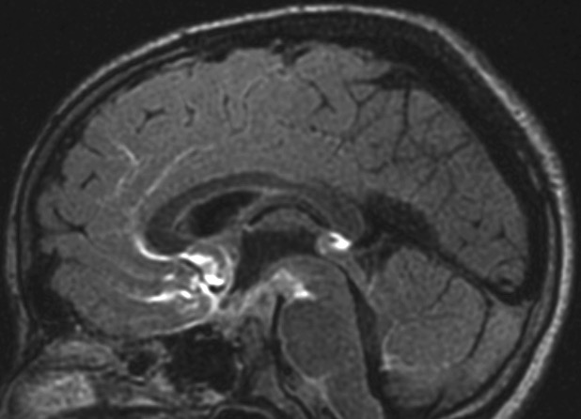
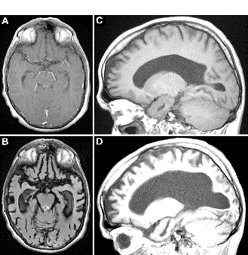
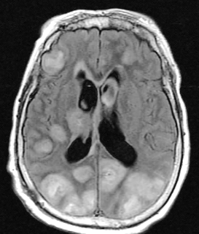
CSF Metagenomic Sequencing
Neuroleptospirosis
Unanticipated bacterial infection
48-hour turnaround
Dramatic clinical improvement
Cache Valley virus
New cause of chronic encephalitis
Undetected spread of an arbovirus to a new continent
Balamuthia mandrillaris
Unanticipated amoebic infection
New cause of endophthalmitis
Neurocysticercosis masquerading as TB arachnoiditis
Common infection with unusual phenotype
Perils of adjunctive steroids
Wilson MR, et al. NEJM 2014
Wilson MR, et al. Ann Neurol 2015
Wilson MR, Suan D, et al. Ann of Neurol 2017
Wilson MR, O’Donovan B, Gelfand J, et al. JAMA Neurol 2018
Beck E, et al. Ann Neurol 2019
Wilson MR, Sample HA, et al. NEJM 2019

Slide 6
Disadvantages of Direct Detection Assays
Short time windows for detection
Compartmentalized / focal infections may shed little to no genetic material into the cerebrospinal fluid

Slide 7
Many neuroinvasive viruses diagnosed by CSF serology
West Nile virus
Powassan virus
Japanese encephalitis virus
Eastern equine encephalitis virus
Measles virus
Poliovirus
Varicella zoster virus
Rabies virus

Slide 8
Approaches to Antibody Discovery
What we would like:
Next-generation sequencing-compatible
Super cheap
Plate-based
Robot friendly
High signal to noise ratio
Scalable

Slide 9
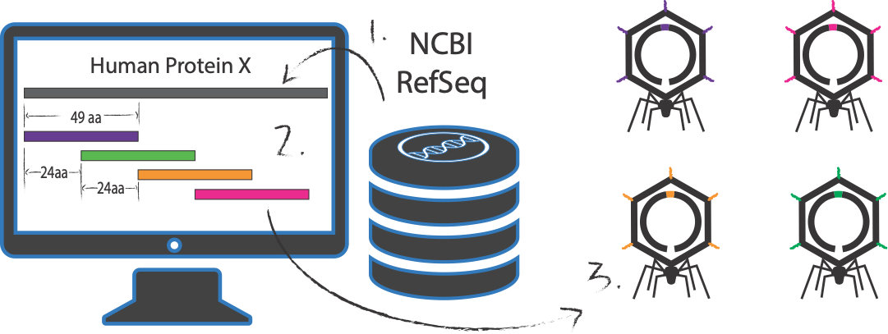
PhIP-Seq: A Rapid Way to Discover Linear Antigenic Targets
Larman HB, et al. Nat Biotechnol 2011
Mandel-Brehm C, Dubey D, et al. NEJM 2019

Slide 10
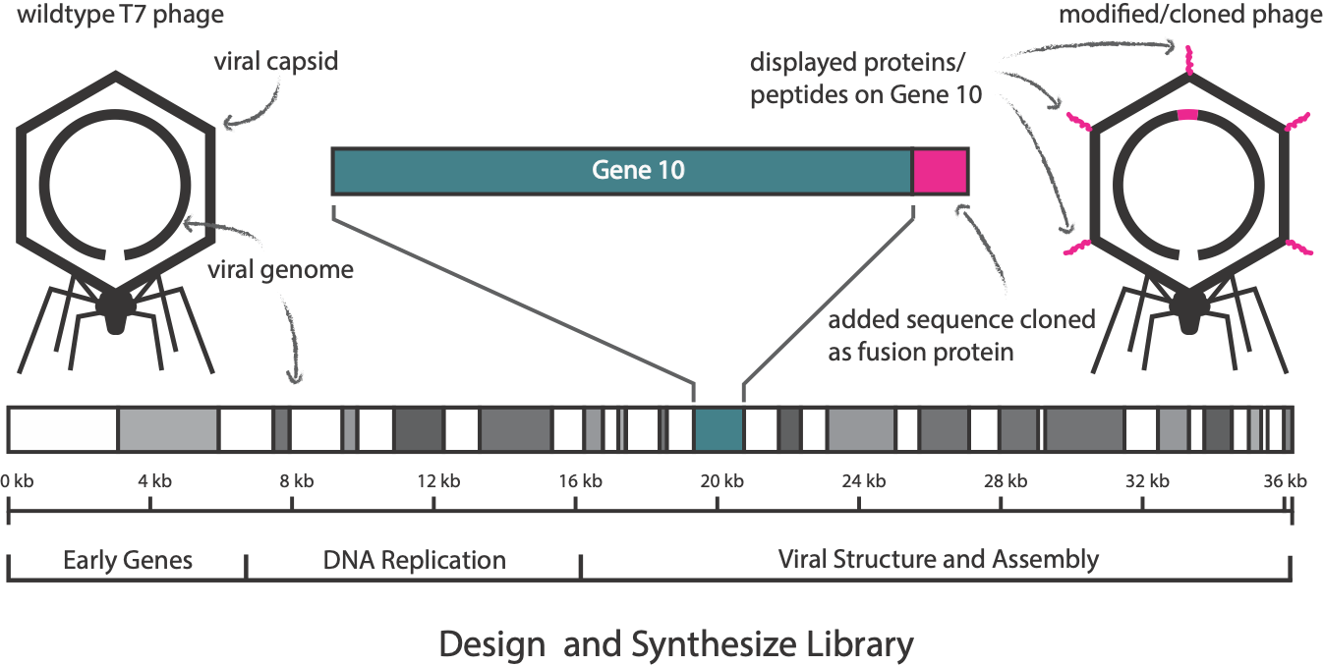
Utilize Phage to Display Every Fragment of Every Human Protein
Larman HB, et al. Nat Biotechnol 2011
Mandel-Brehm C, Dubey D, et al. NEJM 2019

Slide 11
VirScan Design
Final number of representative virus genomes: 76,700
  All vertebrate, tick and mosquito viruses
  Collapsed on 98% amino acid identity
Final number of 62 amino acid peptides overlapping by 14 amino acids: 481,966
Xu GJ, Kula T, Xu Q, Li MZ, Vernon SD, Ndung’u T, et al. Science. 2015
Johnson TP, et al. Ann Neurol 2019
Schubert RD, et al. Nat Med 2019

Slide 12
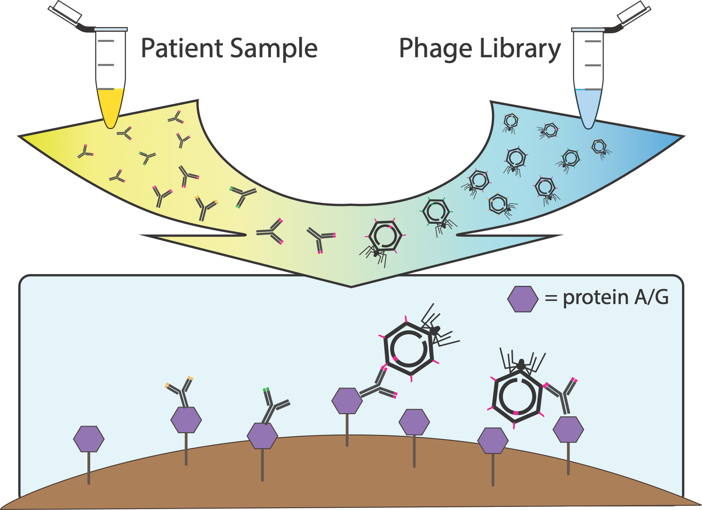
Magnetic Bead

Slide 13






AFM Etiology Study
CSF samples from children with AFM (n=42)
  Median age: 37.8 months, IQR 11 to 64 months
  2018 (n=36), 2014 (n=4), 2016 (n=2)
CSF samples from children with other neurologic diseases (n=58)
  Median age: 120 months, IQR, 66 to 174 months
  Infectious (40%), Autoimmune (38%), Non-inflammatory (10%), Malignancy (5%), Unknown (7%)

Slide 14
CSF VirScan Detects Enterovirus Ab in AFM
AFM: mean Picornaviridae reads 11,082 rpK, IQR 16,850
OND: mean Picornaviridae reads rpK 1121 IQR 974
  p-adjusted = 6.3 x 10⁻⁸ Wilcoxon signed-rank test with Bonferroni adjustment
Schubert RD, et al. Nat Med 2019

Slide 15
CSF VirScan Detects Enterovirus Ab in AFM
AFM: mean Picornaviridae reads 11,082 rpK, IQR 16,850
OND: mean Picornaviridae reads rpK 1121 IQR 974
  p-adjusted = 6.3 x 10⁻⁸ Wilcoxon signed-rank test with Bonferroni adjustment
Enriched Picornaviridae peptides belonged almost entirely to the genus Enterovirus
69% (29/42) of AFM cases versus 7% (4/58) of OND controls considered positive for EV antibodies by VirScan
Schubert RD, et al. Nat Med 2019

Slide 16
AFM CSF antibodies target multiple EV antigens
Schubert RD, et al. Nat Med 2019
Mishra N, et al. mBio 2019

Slide 17
No Difference in EV Antibody Detection Based on Presence of Viral Nucleic Acid
Schubert RD, et al. Nat Med 2019

Slide 18
Pediatric Brainstem Encephalitis Outbreak in Catalonia
Casas-Alba D, et al. Clin Micro Infect 2017
Gonzalez-Sanz R, et al. Euro Surveillance 2019
Leon KE, Schubert RD, et al. In Press

Slide 19
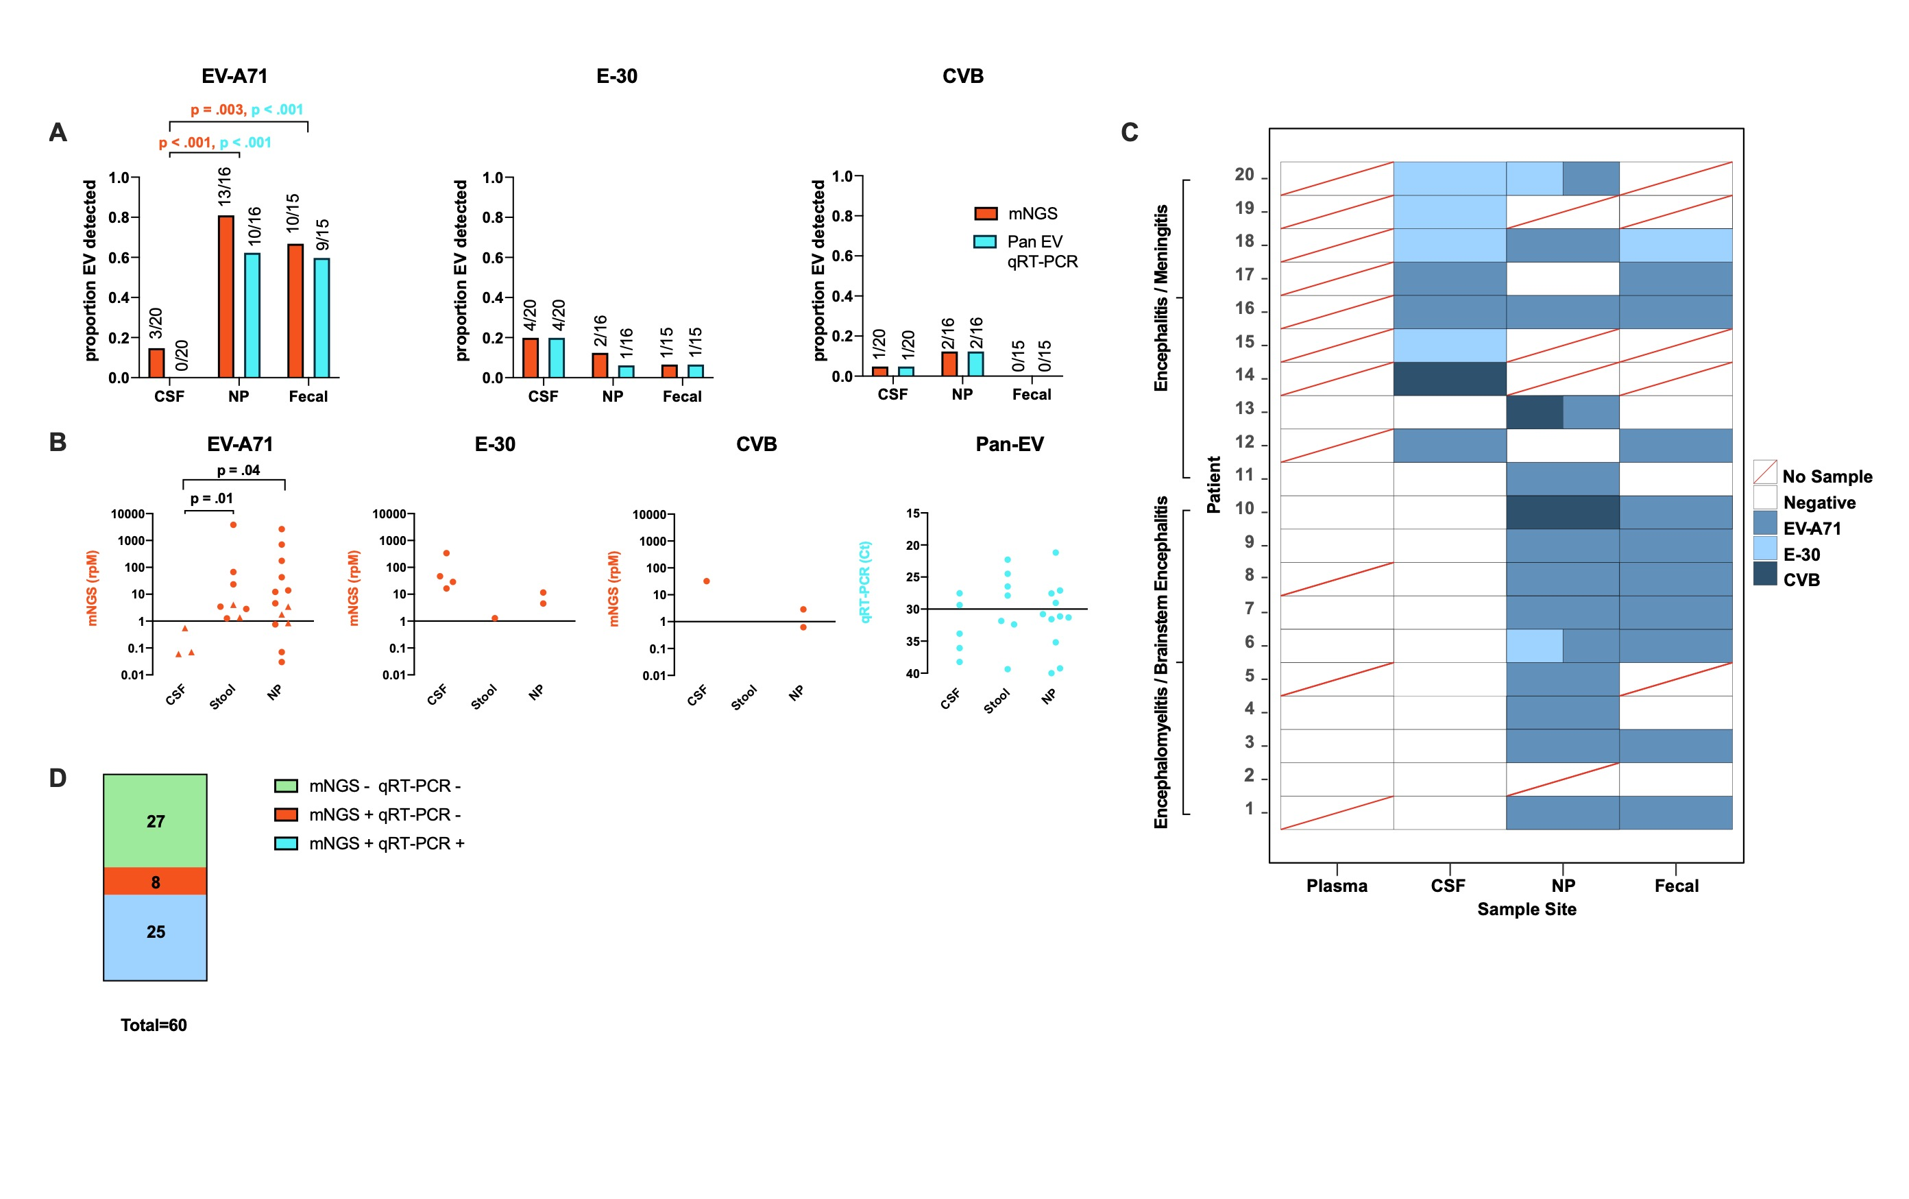
mNGS Enhances Enterovirus Detection
Leon KE, Schubert RD, et al. Neurol Neuroimmunol Neuroinfl 2020

Slide 20
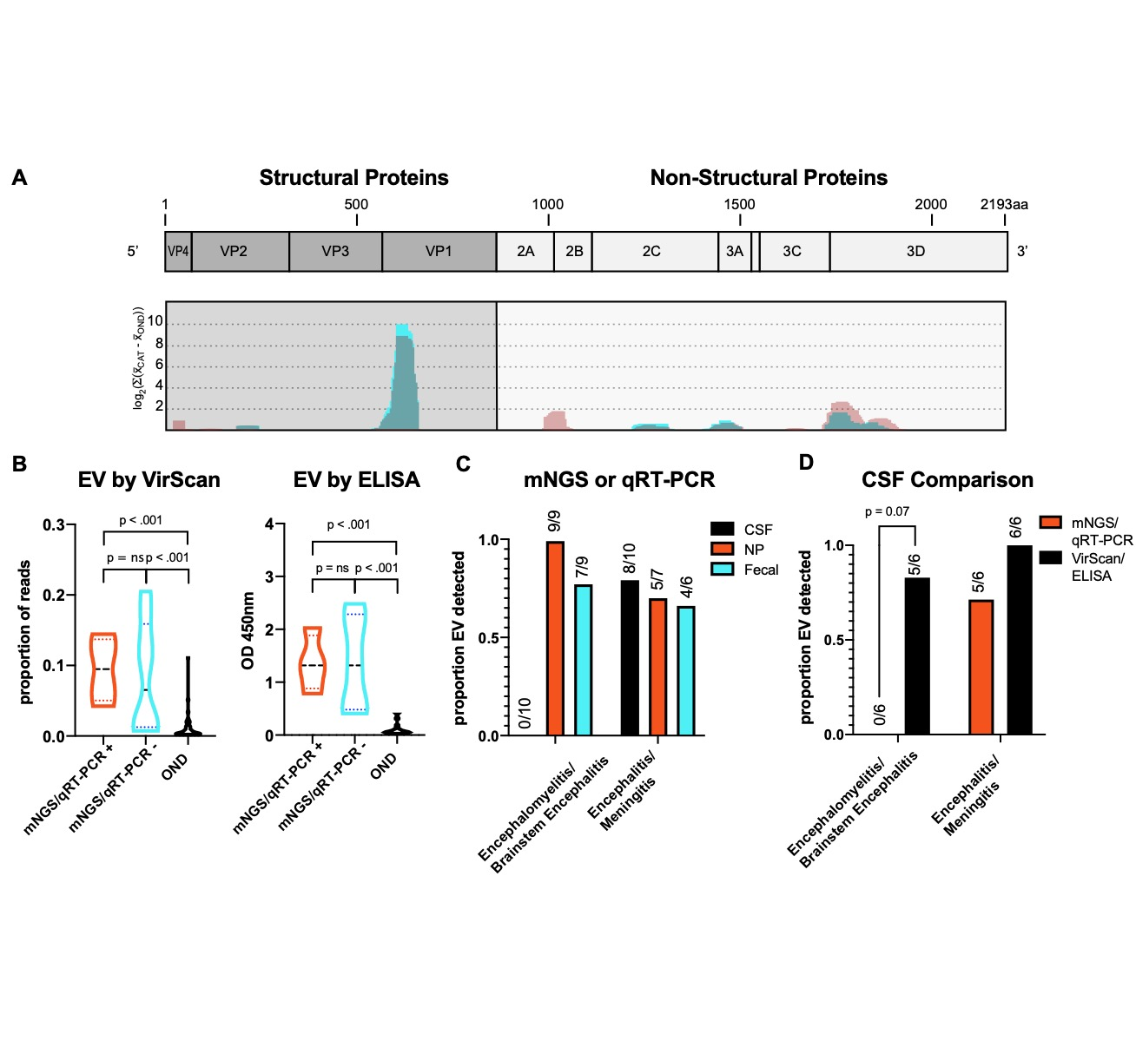
CSF VirScan Detects Conserved EV Antibodies
Leon KE, Schubert RD, et al. Neurol Neuroimmunol Neuroinfl 2020

Slide 21
EV Antibody Titers Independent of Direct Detection Results
Leon KE, Schubert RD, et al. Neurol Neuroimmunol Neuroinfl 2020

Slide 22
Conclusions
Comprehensive viral antibody profiling can shed additional light on neuroviral infections, especially when direct detection methods are insensitive
Limitations of phage display
  Conformational epitopes not well represented
  Lack of post-translational modifications
Schubert RD, et al. Nat Med 2019
Mishra N, et al. mBio 2019
Leon KE, Schubert RD, et al. Neurol Neuroimmunol Neuroinfl 2020

Slide 23
Epidemiology
of AFM
Carol Glaser DVM MD @ Kaiser
How to identify
AFM cases
Keith Van Haren MD @ Stanford
Chris Sonne MD @ Kaiser
How to report
AFM cases
Lauren Stockman MPH @ CDPH
Specimens to collect
for AFM Testing
Debra Wadford PhD @ CDPH/VRDL
What to expect
from lab results
Michael Wilson @ UCSF
Virus and/or antibody detection (VRDL)
Viral DNA/RNA detection using mNGS (UCSF)
Viral antibody screening with phage display (UCSF)

