Slide 1
Clinical and Public Health Approaches to Acute Flaccid Myelitis: Diagnosis, Management, and Reporting in California
August 19, 2020

Slide 2
Epidemiology
of AFM
Carol Glaser DVM MD @ Kaiser
How to identify
AFM cases
Keith Van Haren MD @ Stanford
Chris Sonne MD @ Kaiser
Deb Wadford, PhD, MS, PHM, M(ASCP)^{CM}
Chief, Viral and Rickettsial Disease Laboratory
California Department of Public Health
How to report
AFM cases
Lauren Stockman MPH @ CDPH
Specimens to collect
for AFM Testing
What to expect
from lab results
Michael Wilson @ UCSF
California Department of Public Health

Slide 3
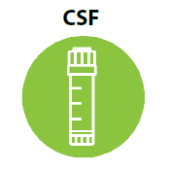
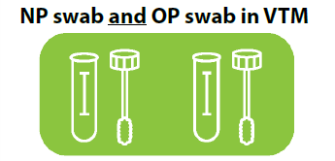
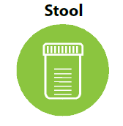
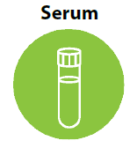
Specimens Requested
Collect specimens as early as possible in the course of illness to increase the chance of virus detection.
CSF
NP Swab
Stool
Serum
2-3 cc
OP Swab
In VTM
In VTM
Quarter-sized
2-3 cc
Preferably before IVIG administered
Preferably before IVIG administered
2 samples collected 24 hours apart

Slide 4
AFM Laboratory Testing
Molecular
testing at VRDL
Rhinovirus¹
St. Louis encephalitis virus³
Comprehensive antibody testing
Adenovirus¹
SARS-CoV-2
(when not previously tested)
West Nile virus²
Metagenomics
Testing at UCSF
Zika virus⁴
Dengue virus⁴
Chikungunya virus⁴
Serology
testing at VRDL
Enterovirus¹
Host biomarker & pathogen discovery
¹ Molecular typing by sequence analysis will be attempted for specimens that are PCR positive for enterovirus, adenovirus, or rhinovirus.
² During transmission season only
(May – Dec).
³ In counties with SLEV environmental detections.
⁴ If indicated by travel history.

Slide 5
Epidemiology
of AFM
Carol Glaser DVM MD @ Kaiser
How to identify
AFM cases
Keith Van Haren MD @ Stanford
Chris Sonne MD @ Kaiser
How to report
AFM cases
Lauren Stockman MPH @ CDPH
As early as possible, collect:
CSF and serum
NP and OP
Stool (2x; 24hrs apart)
Specimens to collect
for AFM Testing
Debra Wadford PhD @ CDPH/VRDL
What to expect
from lab results
Michael Wilson @ UCSF

