Slide 1

Welcome to
California COVID-19 Vaccination Program
Friday Provider Office Hours
Friday, September 17, 2021

Slide 2
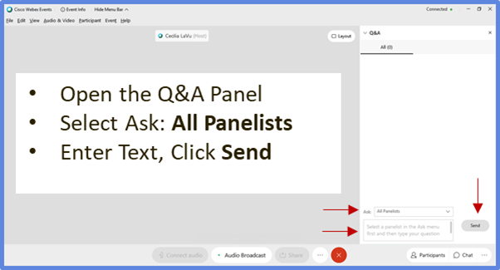
Provider Office Hours Q&A
During the session, please use the Q&A panel to comment or ask a question:
Q&A Panel
Open the Q&A panel
Select Ask: All Panelists
Enter Text, Click Send
Notes:
Grace:
- Welcome all, the webinar
- Two ways to communicate (Cecilia's script)
- Introduce Kathleen

Slide 3


Housekeeping
Reminder to Panelists:
Please mute yourself when not speaking.
Please monitor the Q&A panel for questions you may be able to answer.
Reminder to Participants:
Please access today's slides and archived presentations at: https://eziz.org/covid/education/

Slide 4
Agenda: Friday, September 17, 2021
No.​ | Item​ | Speaker​ | Time (AM)​
1​ | Welcome & Announcements​ | Leslie Amani (Moderator)​ | 9:00 – 9:05
2​ | Vaccine Administration | Amy Pine (CDPH) | 9:05 – 9:10
3 | Data Improvement / Capacity Needs/ Booster Doses | Jennifer Womack (CDPH) | 9:10 – 9:15
4 | Enrollment & CalVaxGrant | Nisha Gandhi (CDPH) | 9:15 – 9:20
5 | Clinical Update | Louise McNitt, M.D. (CDPH) | 9:20 – 9:25
6 | Storage & Handling | Alan Hendrickson (CDPH) | 9:25 – 9:30
Q&A ​ |  |  | 9:30 – 9:40
7 | Vaccine Management | Maria Volk & Claudia Aguiluz (CDPH) | 9:40 – 9:50
8 | Wrap Up & Resources | Leslie Amani (Moderator) | 9:50 – 10:00
Q&A​

Slide 5
Announcements

Slide 6
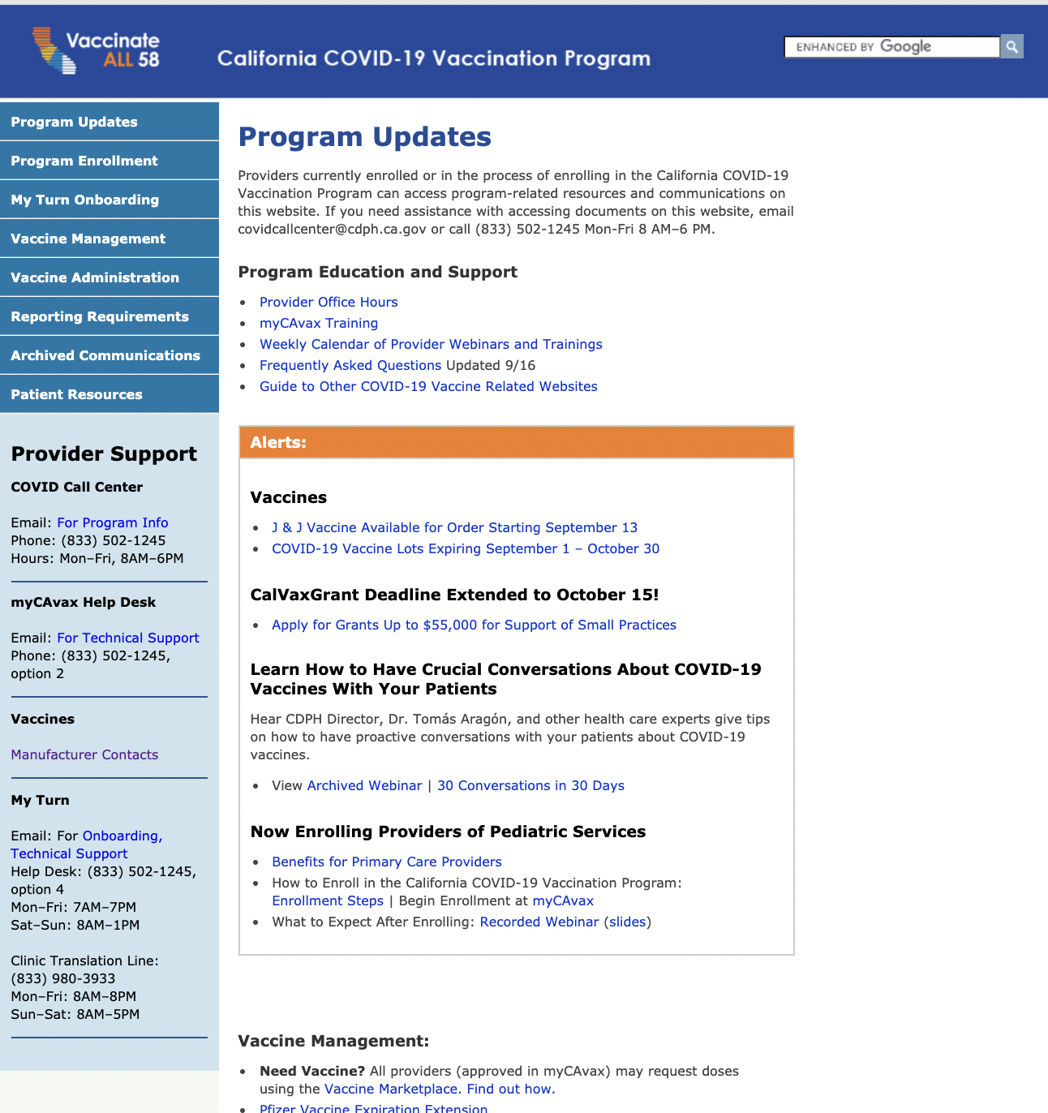
Stay informed!
Provider Resources on eziz.org/covid
Frequent Content Updates:
Alerts
Program Enrollment
My Turn Onboarding
Reporting Requirements
Patient Resources
Archived Communications
Education & Support Materials
More to explore!

Slide 7
COVID-19 Vaccination Program
Webinars and Training for Providers: Week of September 20, 2021 Note: Calendar subject to change
 | Monday 9/20 | Tuesday 9/21 | Wednesday 9/22 | Thursday 9/23 |  | Friday 9/24
myCAvax | myCAvax Vaccine Order Request with Q&A 10:00 am – 10:30 am PW: myCAvax2021! | What’s New in myCAvax for Reactivated Providers 12:00 pm – 12:30 pm | Provider 101 Account Enrollment 10:00 am – 10:30 am PW: myCAvax2021! | What’s New in myCAvax for Reactivated Providers 12:00 pm – 12:30 pm
Combined myCAvax and My Turn Office Hours and Events | My Turn and myCAvax Office Hours 12:00 pm – 1:00 pm PW: Immunize2020! | Provider COVID-19 Vaccine Booster Dose Town Hall 3:00 pm – 4:00 pm | My Turn and myCAvax Onboarding Office Hours 1:00 pm – 2:00 pm |  |  | Provider Office Hours ​ 9:00 am – 10:00 am​ PW: Immunize2021!​ Provider COVID-19 Vaccine Booster Dose Town Hall 3:00 pm – 4:00 pm
View On Demand | Provider 101 Account Enrollment (v. 8/11/21) Introduction to My Turn Onboarding (v. 8/27/21) |  | Vaccine Marketplace (v. 8/26/21) What’s New in myCAvax (v. 8/24/21) |  | What’s New in myCAvax for Reactivated Providers (v. 9/8/21)
Help
Website: www.eziz.org/covid, FAQs
General email: covidcallcenter@cdph.ca.gov
CDPH Provider Call Center: 1-833-502-1245, 8am-6pm
My Turn email: myturnonboarding@cdph.ca.gov
myCAvax Help Desk Email: myCAvax.HD@accenture.com
Phone: (833) 502-1245, option 2
Last updated: 9/16/21 ​

Slide 8
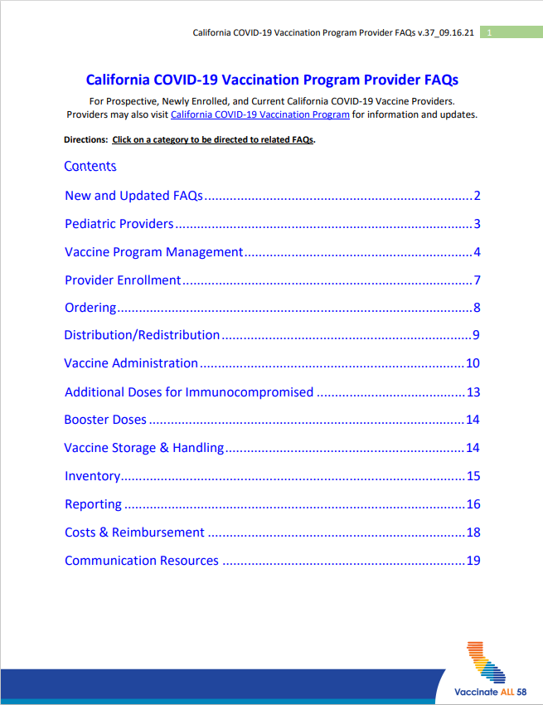
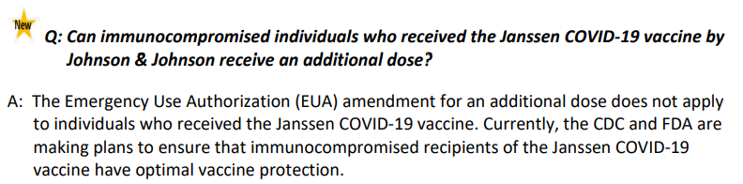
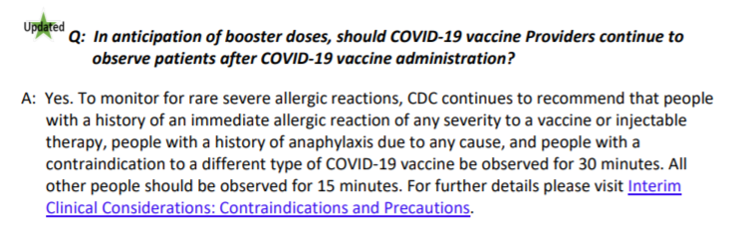
COVID-19 Vaccine Provider FAQs
Answers to Provider questions
Updated weekly: Last updated 09.16.2021
Currently in its 37th iteration!
Provider FAQs on EZIZ

Slide 9
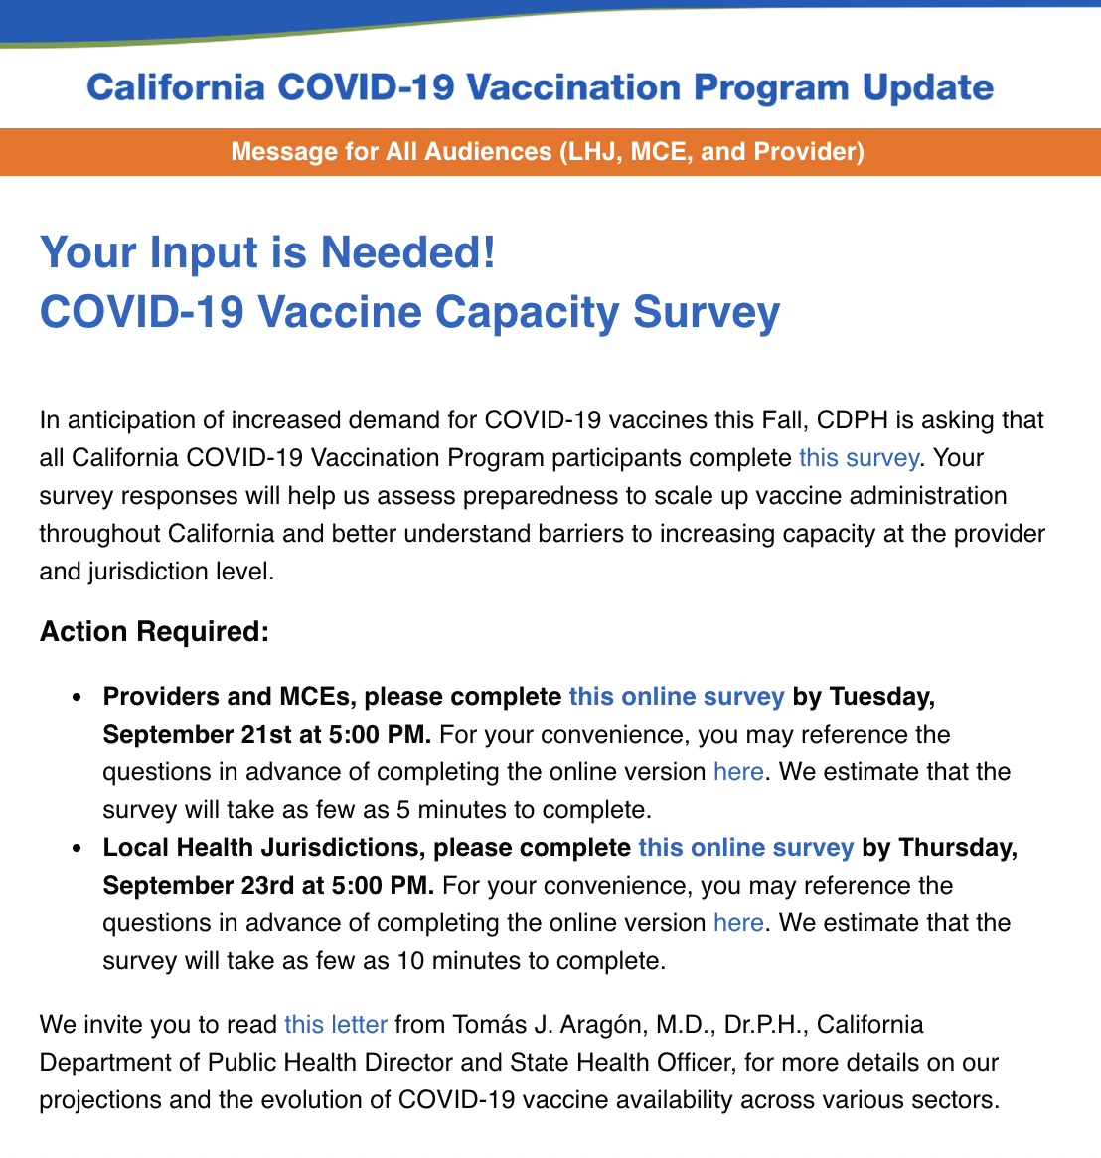
Capacity Survey: Your Participation Needed!
Action Required! We need your help to prepare for potential increase
in demand for COVID-19 vaccines!
Survey for Providers, Multi-County Entities, and Local Health Jurisdictions sent this morning from COVIDCallCenter@cdph.ca.gov.
View archived message.
Upcoming Town Halls for Providers
Led by Dr. Tomás Aragón, CDPH Director and State Public Health Officer, these town halls are to help prepare providers to increase their vaccination capacity. We'll cover:
  Vaccination projections for the next 6-8 months
  Vaccine ordering guidance
  Steps to prepare clinics for the increased vaccine demand
Tuesday, September 21, from 3 PM - 4 PM Click here to register
Friday, September 24, from 3 PM - 4 PM Click here to register

Slide 10

California State Public Health Order
Dr. Tomás Aragón, State Public Health Officer, is drafting a Public Health Order on the following:
  When reporting vaccinations to the California Immunization Registry (CAIR), COVID-19 Vaccine Providers will be required to collect and submit the patient’s email address and cell phone number, if known.
  Patients will not be required to supply this information to be vaccinated. However, not supplying an email address or cell phone number will make it difficult for a patient to obtain a California Digital COVID-19 Vaccine Record (DCVR)*.
  Anticipate that the Order will take effect shortly.
Please provide input on any potential obstacles or barriers to implementing this Order in the chat or by emailing leslie.amani@cdph.ca.gov.
*Patients can use their DCVR to verify their vaccination status or to replace a lost paper vaccination card.​
Find All Guidance (ca.gov)

Slide 11

Rural Communities Webinar: How to Have Conversations about COVID-19 Vaccines
Please join Dr. Jasmeet Bains, based in Kern County, California, for a webinar training on how to effectively communicate with your patients about COVID-19 vaccines in rural communities.
This training will cover:
The latest data and insights on COVID-19 vaccination rates in rural communities.
Key messages addressing common patient concerns about the COVID-19 vaccine.
Communication tools for effective patient conversations.
Register here: Monday, September 27 at 12:00PM
30 Conversations in 30 Days webpage

Slide 12


Recent Webinars You May Have Missed:
CDC hosted a Clinician Outreach Communication Activity (COCA) Call: "Influenza Vaccination Recommendations and Guidance on Coadministration with COVID-19 Vaccines." View slides or watch the archive.
CDPH hosted a second webinar on "How to Have Crucial Conversations about COVID-19 Vaccines." View slides or watch the archive.
  Find more information about the “30 Conversations in 30 Days” campaign at https://eziz.org/covid/30conversations/

Slide 13

COVID-19 Vaccination Field Guide:
12 Strategies to Help Increase COVID-19 Vaccine Confidence and Demand (CDC)
Outlines strategies which address common barriers (structural, behavioral, informational) to help increase vaccine confidence and uptake.
Includes examples from communities currently using these strategies to increase COVID-19 vaccine confidence and uptake.
Access COVID-19 Vaccination Field Guide here

Slide 14
Vaccine Administration
Amy Pine, CDPH

Slide 15
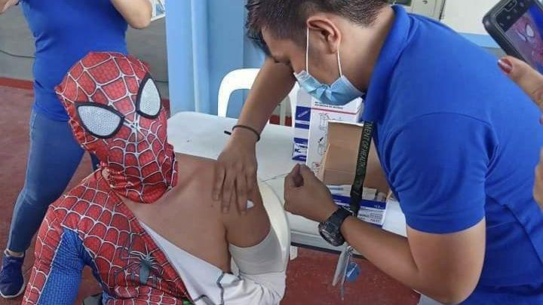
Doses Administered to Date (9/15/21)
48,219,430 doses administered!
78.4% of 12+ population has received at least one dose and 68.6% are fully protected!
82.55% of 65+ population has received at least one dose (72.9% fully protected)
59.47% of 12-to-15-year-olds have received at least one dose (49.61% fully protected)
Even Super Heros Need Protection!
6,106,448 Doses on hand - 78 days of inventory.
Notes:
This is a 5.9% from the week prior (+18,580 doses)
This is a 24.2% increase from two weeks prior (+65,328)

Slide 16
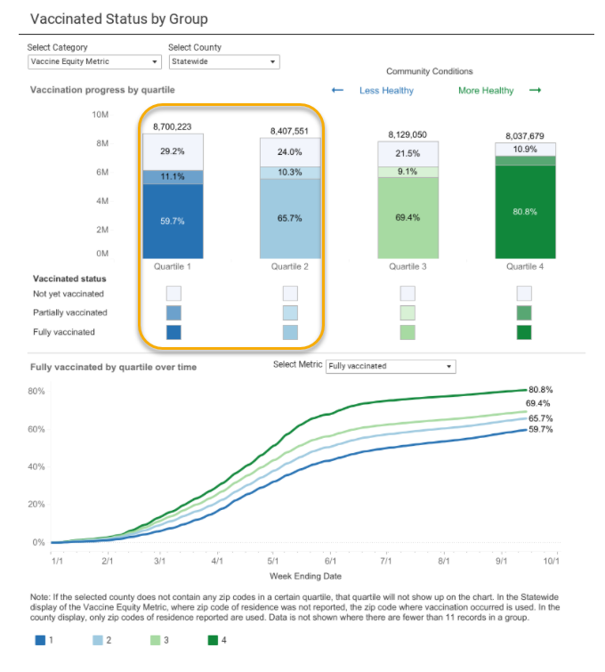
Vaccine Equity Metric
69.8% of Q1 population has received at least one dose
76% of Q2 population has received at least one dose
Over 4.5 million people from quartiles 1 and 2 have not yet been vaccinated

Slide 17
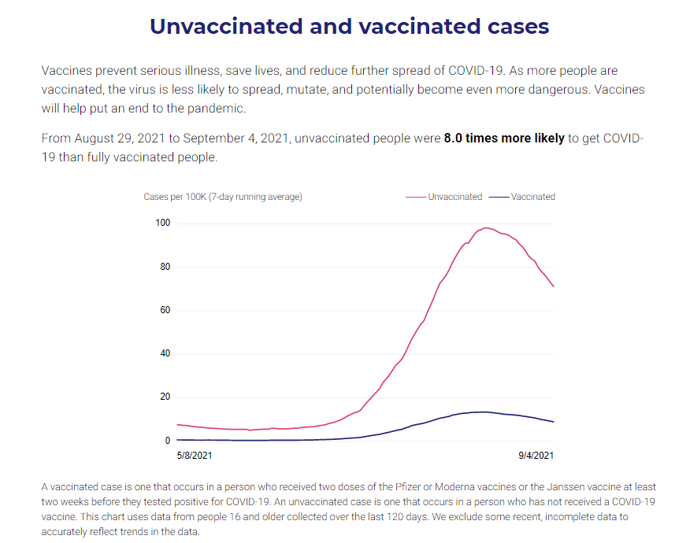
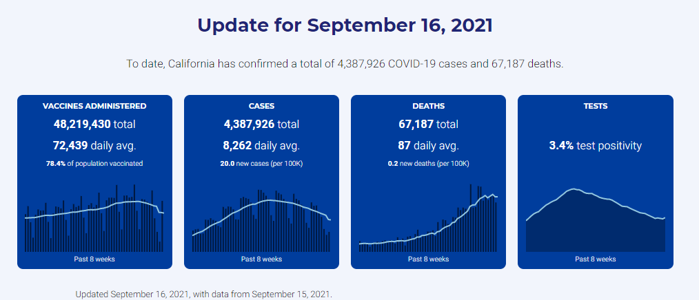
New Addition to CA Data Dashboard
https://covid19.ca.gov/state-dashboard/
https://covid19.ca.gov/vaccination-progress-data/

Slide 18
Data Improvement, Capacity Needs and Booster Doses
Jennifer Womack, CDPH

Slide 19
Data Improvements – Percentage Changes
Updated bridging/de-duplication logic will be applied to the COVID-19 vaccination dataset on Friday, September 17, 2021
  Will help bridge data for individuals with more than one recipient ID across the CAIR2, SDIR, and RIDE registries
  Logic is already being used to improve the accuracy of the DCVR
  Counties may see decreases in coverage rates as a result
Discrepancies between CDPH and CDC dashboards
  CDC includes data from federal agencies (VA, DOD, BOP, IHS)
  CDC uses different population estimates
  Updates or deletions made to CA data are not reflected on CDC dashboards; CDC working on a way for jurisdictions to submit updates

Slide 20
Executive Summary
CDPH has closely monitored the anticipated changes in eligibility and demand, and has updated scenarios of vaccine demand and administration based on latest information:
  Boosters (Pfizer initially) - September 20, 2021, or later and children 5-11 years of age (Pfizer vaccine) - October 15, 2021, or later.
  Under the Sept 8th scenarios¹, total demand for COVID-19 vaccine may be 30-36M doses by end of 2021 and up to 63M by end of 2022² (47.5M doses have been administered to date³).
  To meet this demand, California may need to increase rate of vaccine administration by 5-8x (from ~80K per day to ~400-600K doses / day) within the next 4-12 weeks ², as well as prepare for equity, policy, and other considerations.
1. Scenarios represented are a few of many models under consideration and are not illustrative of the full scope of scenarios considered (Source of Sept 8th scenarios: Snowflake (data as of 8/16/2021), assumptions developed with CDPH working team guidance)
2. Based on scenarios being illustrated, as developed with CDPH working team guidance. Range based on the two scenarios included in these pages.
3. CDPH vaccine summary dashboard as of 9/8/2021
Preliminary; as of SEPTEMBER 9, 2021

Slide 21
Scenario: Daily administration requirement for 8-months booster eligibility^{1,2}
Aa: Blue text indicates defining variables and outputs
Daily administration requirement, M doses
Immunocompromised
65+
12-64
Under 12
1
2
3
4
5
6
If Moderna booster is approved 2 weeks after Pfizer³ and administered 8 months after full vaccination, peak daily demand may be ~370K doses per day and State may remain within historical peak of 410k doses per day⁴
0.8
0.7
0.6
0.5
Potential peak:
~370k doses/day⁴
0.4
0.3
0.2
Current admin.:
~80k doses/day⁵
0.1
0
Jan
Apr
Jul
Oct
Jan
Apr
Jul
Oct
Dec
2021
2022
Timeline assumptions^{1,4,5}
1
2
Booster approved for all age groups 8 months after full vaccination (Pfizer on Sept 20, Moderna on Oct 4)⁴
3
Immunocompromised population eligible to receive boosters⁴
5-11 age group eligible to receive vaccines⁴
4
Booster vaccinations for 16-64 age group begins to rapidly scale
5
0-4 age group eligible to receive vaccines⁴
6
First members of under 12 population become eligible to receive boosters⁴
1. Scenario represented is one of many models under consideration, and is not illustrative of the full scope of scenarios considered
2. See detailed scenario assumptions page for additional scenario details
3. https://www.cnn.com/2021/09/05/health/coronavirus-fauci-moderna-vaccine-booster/index.html
4. Based on scenario being illustrated, as developed with CDPH working team guidance
5. Based on historical data as of August 16 2021 (latest historical data available at time of scenario modeling)
Source: Snowflake (data as of 8/16/2021), assumptions developed with CDPH working team guidance
Preliminary; as of SEPTEMBER 9, 2021

Slide 22
Scenario: Daily administration requirement for 6-months
booster eligibility^{1,2}
Aa: Blue text indicates defining variables and outputs
Daily administration requirement, M doses
Immunocompromised
65+
12-64
Under 12
If Moderna booster is approved 2 weeks after Pfizer³, and State meets all accumulated demand for boosters within 2 weeks of approval, peak daily demand may increase to ~600K doses per day and State may operate for 4 weeks above the historical peak of 410k doses per day⁴
0.8
1
2
3
4
5
6
0.7
Potential peak:
~600k doses/day⁴
0.6
0.5
0.4
0.3
0.2
Current admin.:
~80k doses/day⁵
0.1
0
Jan
Apr
Jul
Oct
Jan
Apr
Jul
Oct
Dec
2021
2022
1
2
Booster approved for all age groups 6 months after full vaccination (Pfizer on Sept 20, Moderna on Oct 4); accumulated demand met within 2 weeks⁴
3
Timeline assumptions^{1,4,5}
Immunocompromised population eligible to receive boosters⁴
5-11 age group eligible to receive vaccines⁴
4
Booster vaccinations for 16-64 age group begins to rapidly scale
5
0-4 age group eligible to receive vaccines⁴
6
First members of under 12 population become eligible to receive boosters⁴
1. Scenario represented is one of many models under consideration, and is not illustrative of the full scope of scenarios considered
2. See detailed scenario assumptions page for additional scenario details
3. https://www.cnn.com/2021/09/05/health/coronavirus-fauci-moderna-vaccine-booster/index.html
4. Based on scenario being illustrated, as developed with CDPH working team guidance
5. Based on historical data as of August 16 2021 (latest historical data available at time of scenario modeling)
Source: Snowflake (data as of 8/16/2021), assumptions developed with CDPH working team guidance
Preliminary; as of SEPTEMBER 9, 2021

Slide 23
Enrollment and CalVaxGrant Update
Nisha Gandhi, CDPH

Slide 24
CalVaxGrant Application
The deadline for the CalVaxGrant application has been extended to October 15, 2021!
Reminder – To apply you must:
Be a small practice provider, school, school-based clinic, and independent pharmacy with 200 physicians or fewer.
Expend or plan to expend award on allowable expenses (noted on website).
Have not received money from the State Innovation Fund.
Visit the CalVaxGrant website for more information.
If you have additional questions, email CalVaxGrant@phcdocs.org

Slide 25

Latest CalVaxGrant Stats
For a full list of eligible Providers visit PHC website
Latest stats:
$20.3 million in funding requested
Category | # applications
Approved | 975
Pending | 48
Not eligible | 16
Incomplete | 458
Total | 1497
$16.7 million in funding remaining

Slide 26
Clinical Update
Dr. Louise McNitt, CDPH

Slide 27
While Waiting for Booster Dose Recommendations:
Outreach to immunocompromised patients for an additional dose.
Outreach to patients who have not been vaccinated for COVID-19.
Send reminders to patients who are overdue for their 2nd dose of Pfizer or Moderna vaccines.
Send reminders to patients who are overdue for other routine vaccines.

Slide 28
While Waiting for Booster Dose Recommendations:
Offer seasonal flu vaccine to all eligible patients:
  CDC 2021 Flu Recommendations
  COCA Call: Influenza Vaccination Recommendations and Guidance on Coadministration with COVID-19 Vaccines
Consider planning additional opportunities for seasonal flu vaccination (after hours clinics, dedicated flu clinics).
Reminder: Other vaccines and TB testing may be done on the same day as COVID-19 vaccines, or within 14 days of any COVID-19 vaccine dose.
  Coadministration of COVID-19 Vaccine with Other Vaccines job aid

Slide 29

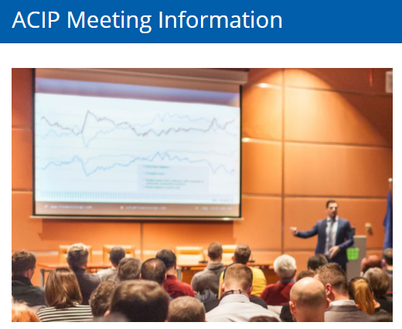
Booster Updates
FDA: Today, Friday, September 17
5:30AM – 12:45PM, PST
  Watch online web conference meeting here
  Find additional information
  ACIP: Wednesday, September 22,
  7AM – 2PM PST and
  Thursday, September 23,
  6AM – 11AM PST
Link: Advisory Committee on Immunization Practices (ACIP) CDC

Slide 30
Storage & Handling
Alan Hendrickson, CDPH

Slide 31
Inventory Reporting
How often should a provider report inventory?
How often do providers report inventory?
Is quarterly inventory reporting adequate?

Slide 32
Waiting for COMIRNATY
COMIRNATY – the rebranded Pfizer COVID-19 vaccine
Potentially, three presentations: adult, adolescent & pediatric
Common to all three:
  ULT shipping and storage
  Dry ice – but no restocking by the federal government
  Shelf-life and beyond use dating
  Vial size - 6 doses per vial
  Order size – smaller order sizes available
  Ancillary supply kits

Slide 33
Waiting for COMIRNATY(Cont’d.)
How they differ:
  NDCs (National Drug Codes)
  Adult (12 or 16 years plus): The vaccine will be premixed so no diluent is required.
  Adolescent (5-11 years): The vaccine requires dilution and dosing is less.
  Pediatric (> 4 years): The vaccine requires dilution and dosage is even less.
When:
  October/November: adult/adolescent
  Unknown for pediatric
  FDA approval/ACIP recommendation

Slide 34
Third-party Redistributor (TPR)
Three weeks in – soft opening to full opening
AmerisourceBergen (AB)
Redistribute small orders of Pfizer to include ancillary supplies
Order size 30 to 450 doses (5 to 75 vials)
CDPH will submit two orders per week
Shipping ULT for normal refrigerated storage (2°C to 8°C)
No ULT storage required on site – order lean.

Slide 35
Third-party Redistributor (TPR)
AB will provide email notification of shipment (1030 – 1600 hrs.)
Shipments insulated boxes packed with dry ice pellets
Providers will need gloves to unpack the boxes
Vaccine & data logger in packing envelope (25 vials max)
Data logger will be set for -94°C to -15°C
Data logger display will not work until the temperature rises – 3 to 5 minutes after removal

Slide 36
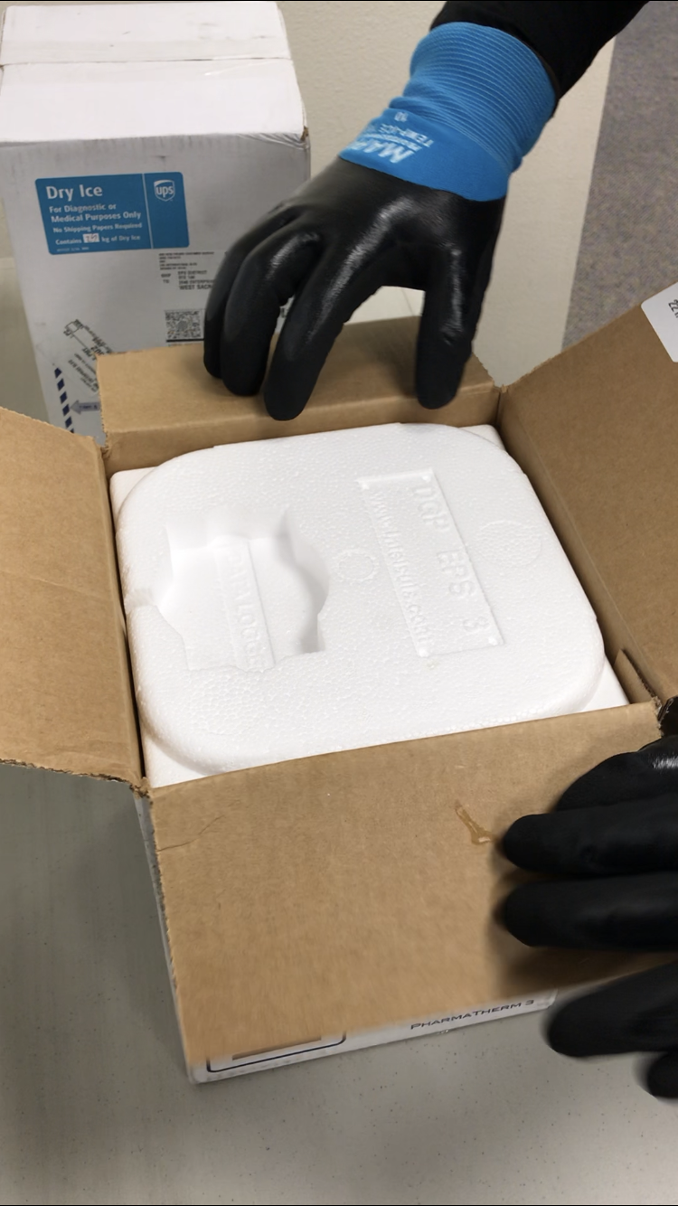
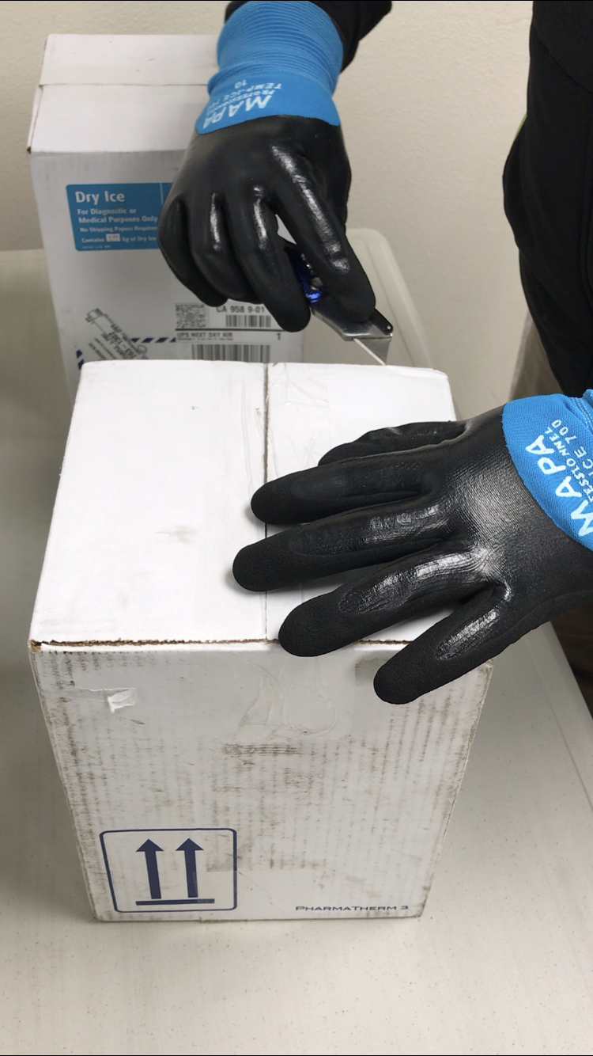
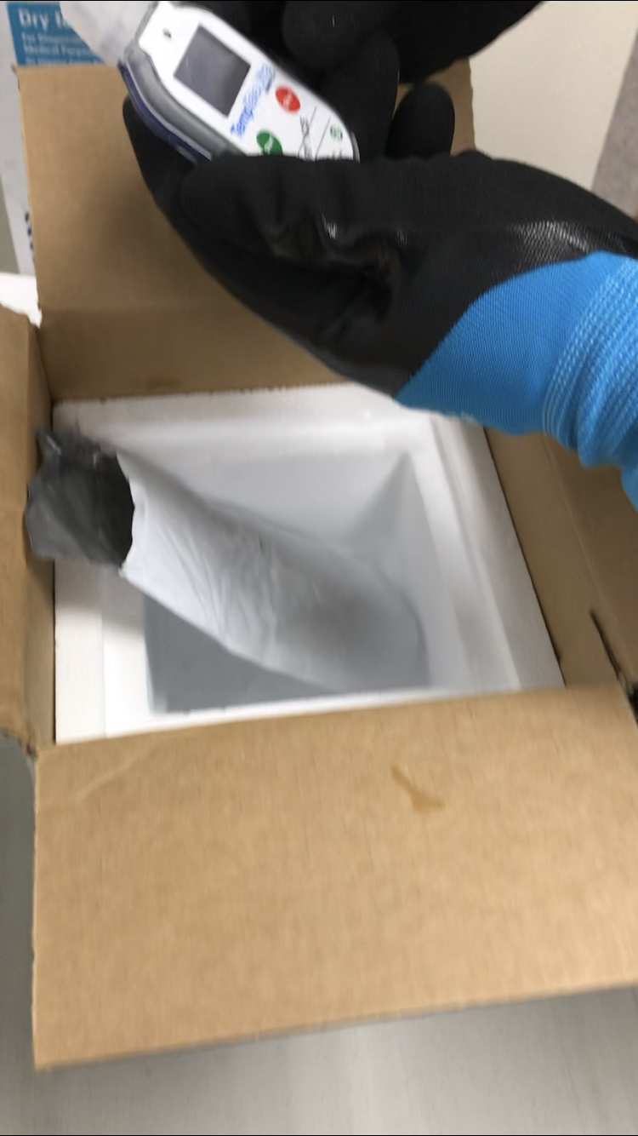
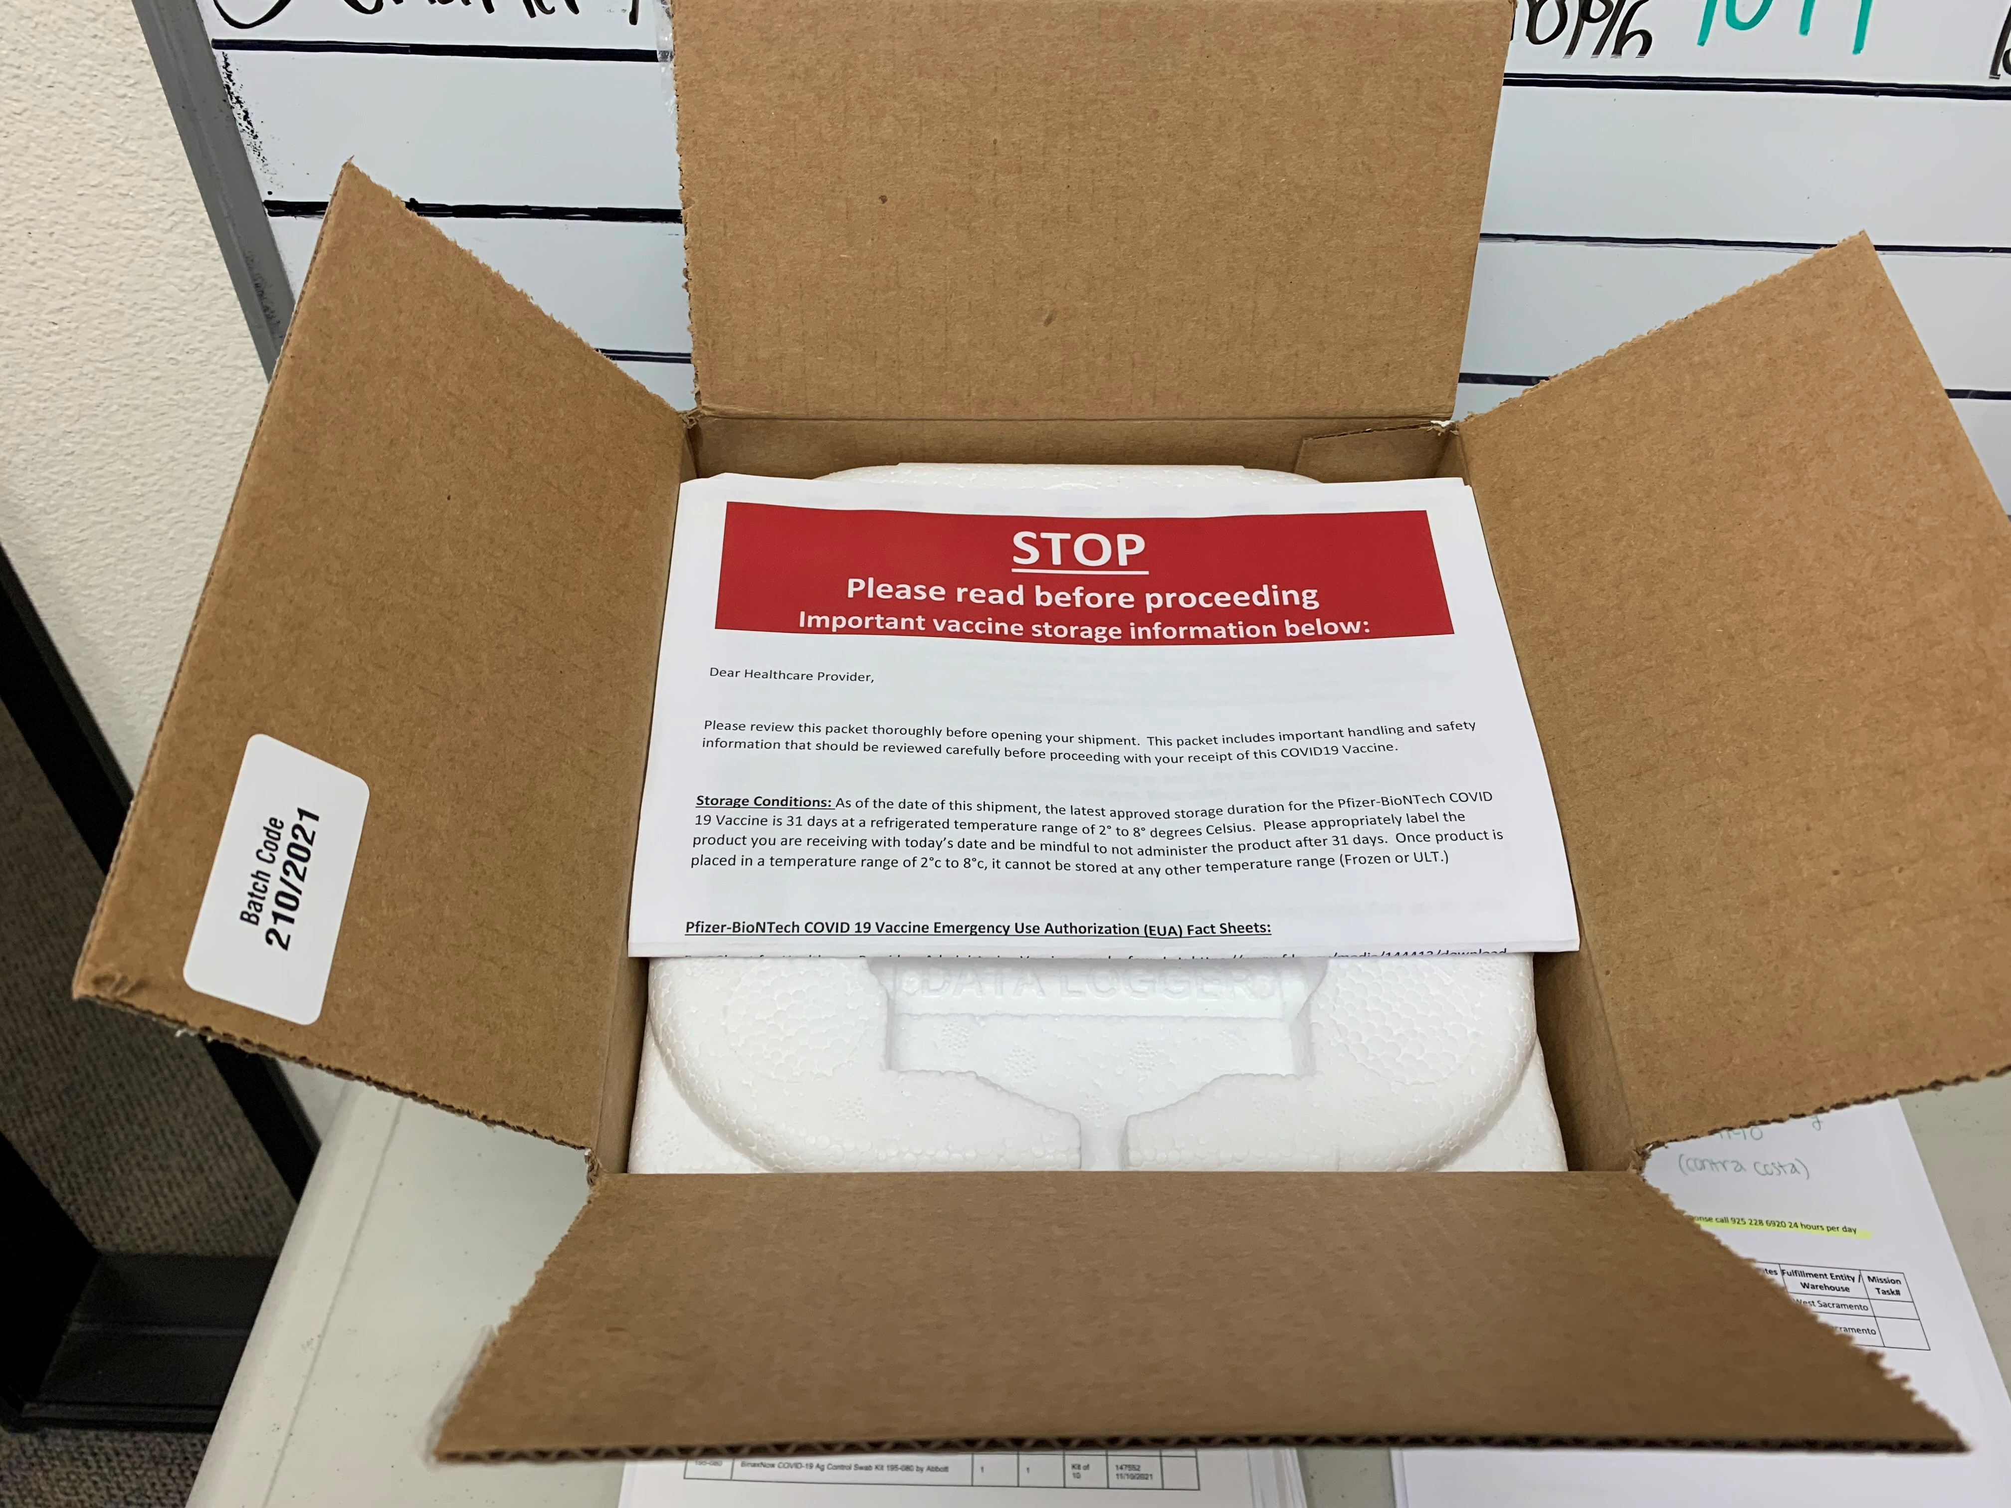
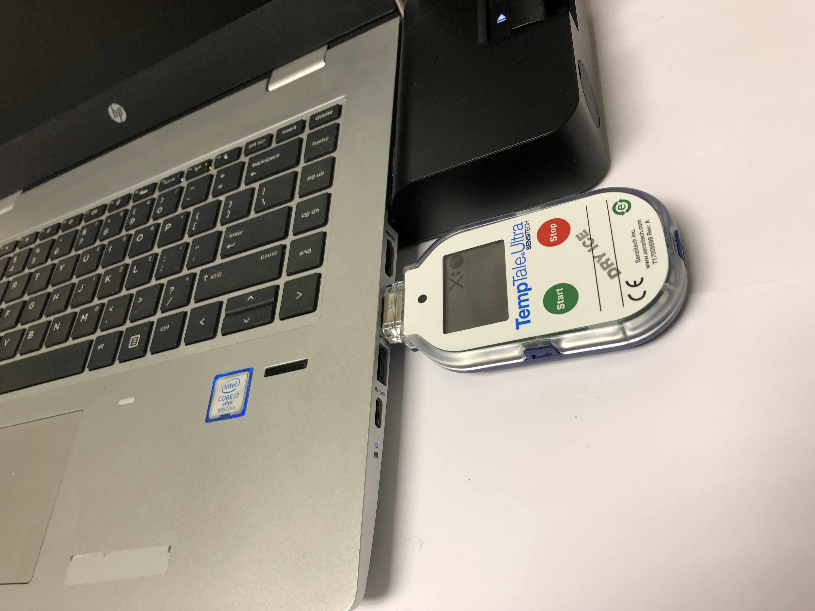
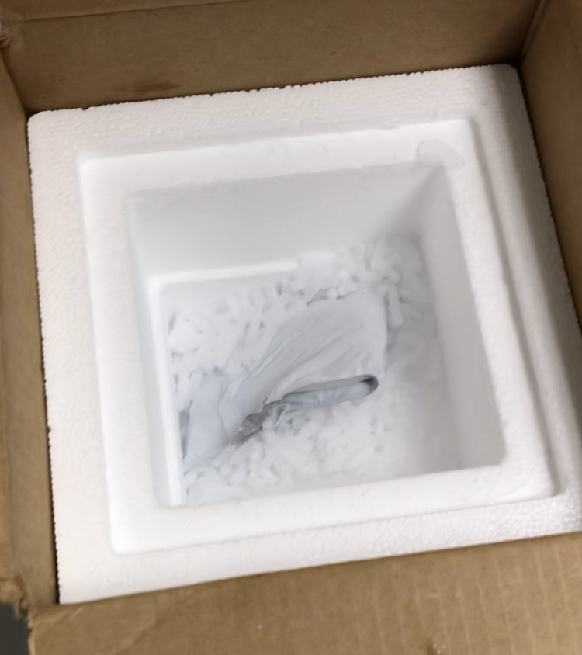
Third-party Redistributor (The Visuals)

Slide 37
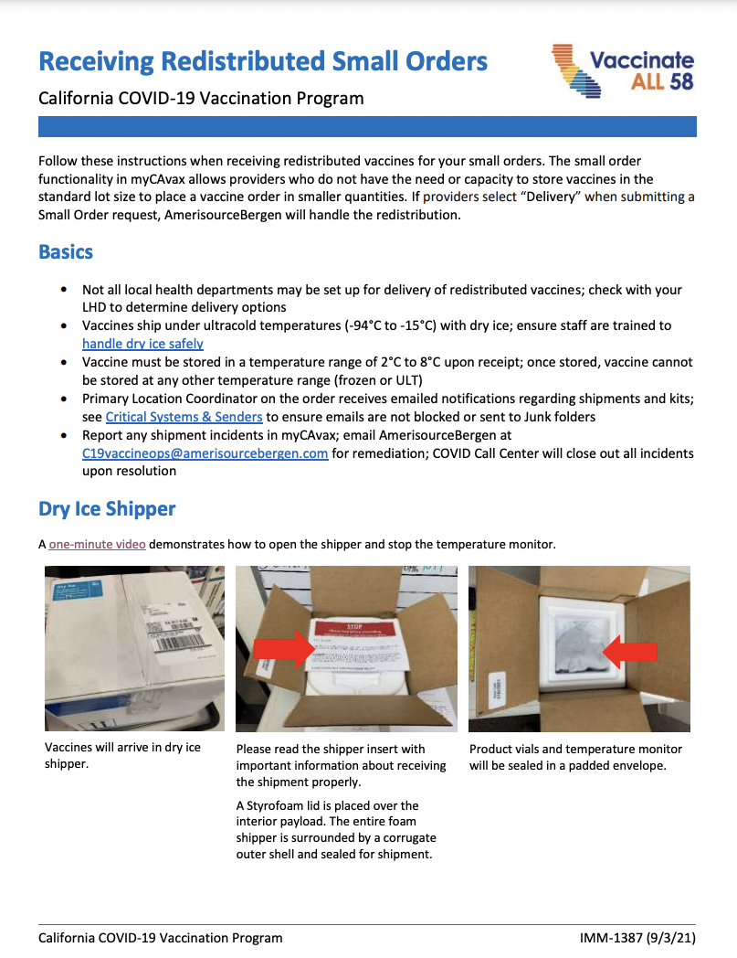
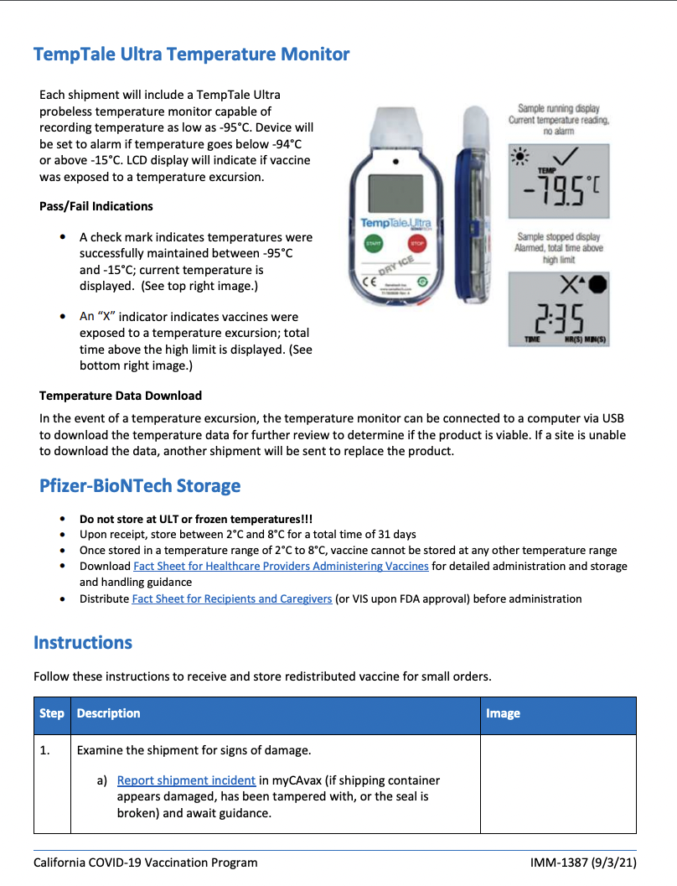
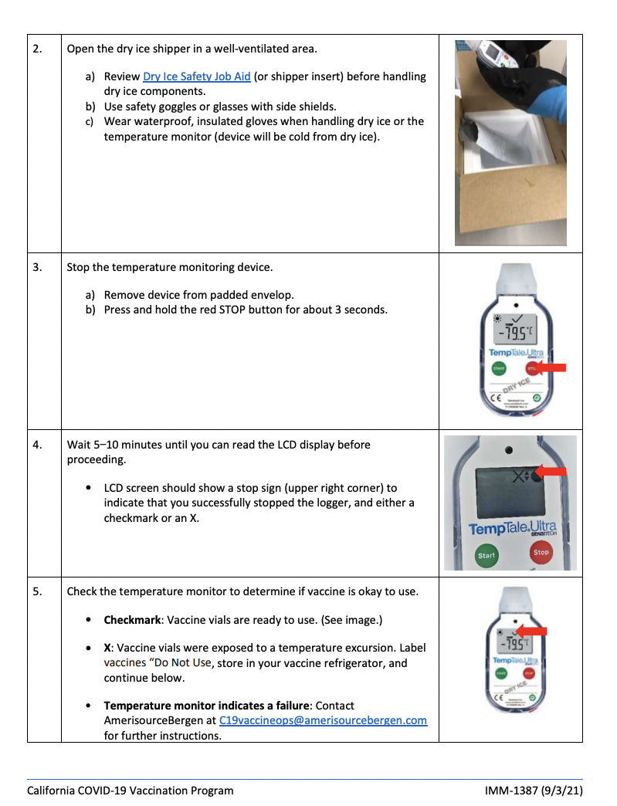
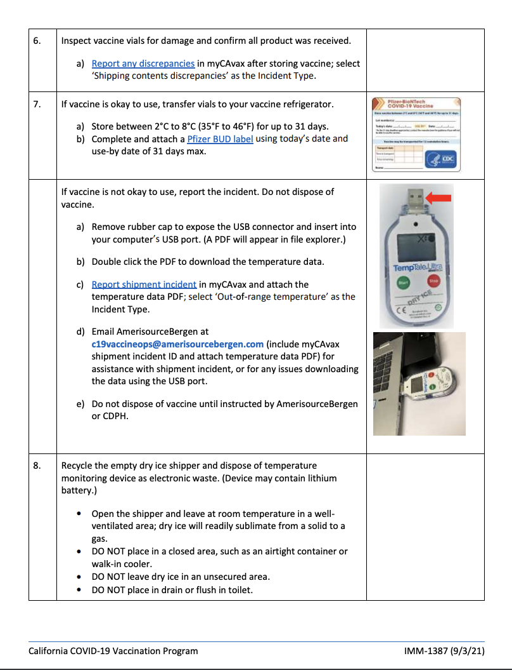
Receiving Redistributed Small Orders
View job aid

Slide 38

Receiving Redistributed Small Orders
TPR job aid:
https://eziz.org/assets/docs/COVID19/IMM-1387.pdf
TPR award-winning YouTube video:
https://www.youtube.com/watch?v=8eo9jxXrKq0

Slide 39
Provider Office Hours Q&A
Please use the Q&A panel to comment or ask a question:
Q&A Panel
Open the Q&A panel
Select Ask: All Panelists
Enter Text, Click Send
Notes:
Grace:
- Welcome all, the webinar
- Two ways to communicate (Cecilia's script)
- Introduce Kathleen

Slide 40
Vaccine Management
Maria Volk, My Turn and Claudia Aguiluz, CDPH

Slide 41
Table of Contents
What’s New on My Turn​
My Turn flu ​Mockup
Upcoming myCAvax Live Trainings​
J&J Vaccine Available for Ordering
Ordering Reminders
Appendix​
  myCAvax Known Issues & Workarounds​
  My Turn and myCAvax Feedback Form

Slide 42

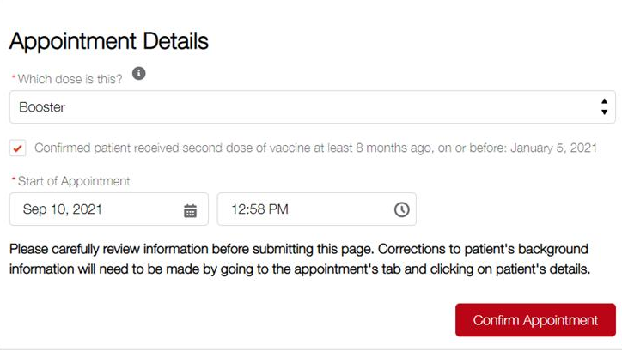
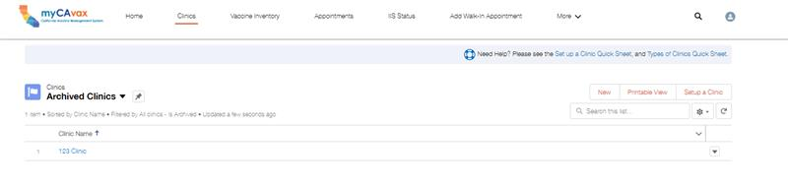
What’s New on My Turn: Release 17 (9/15)
My Turn Clinic
My Turn Public
Booster functionality
  Clinic setup, Walk-in,
  Vaccine Administration flow
Editing Parent / Guardian Information date/time stamp
Archiving clinics
Clinic walk-in tags for additional doses
Booster functionality (9/2021)*
  Screening page with new eligibility questions
  Updated landing page
*My Turn anticipates booster dose functionality to deploy 9/2021 the administration of booster doses to patients currently does not have a guaranteed start date. Please continue to wait for regulatory approvals before administering booster doses.​
**More details to come 9/23.

Slide 43
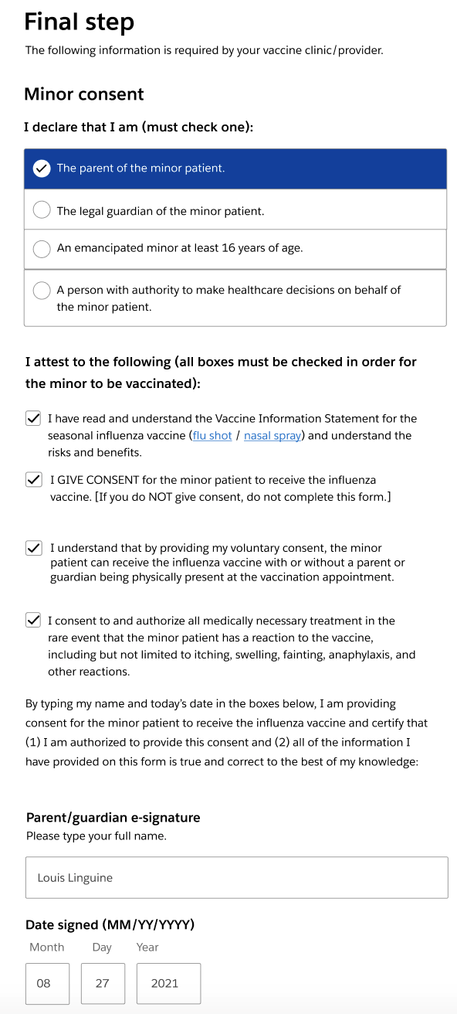
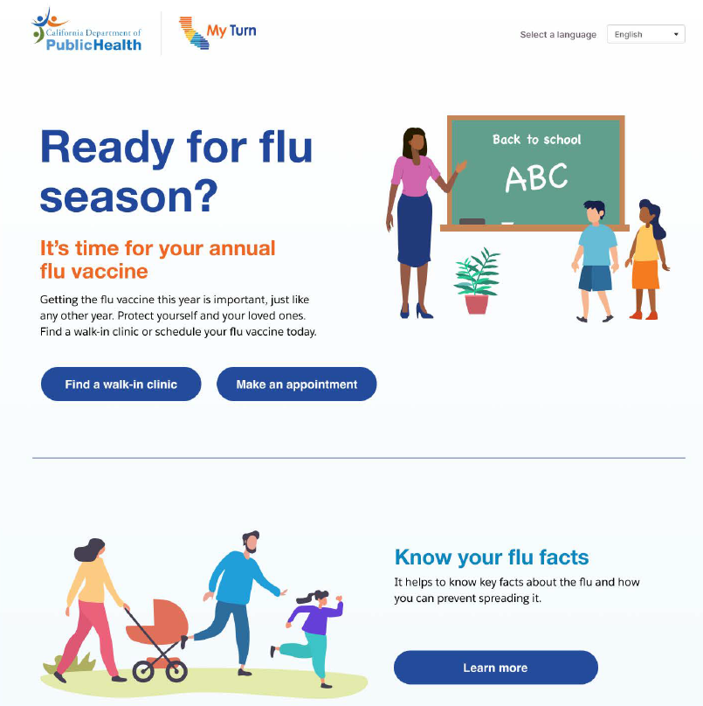
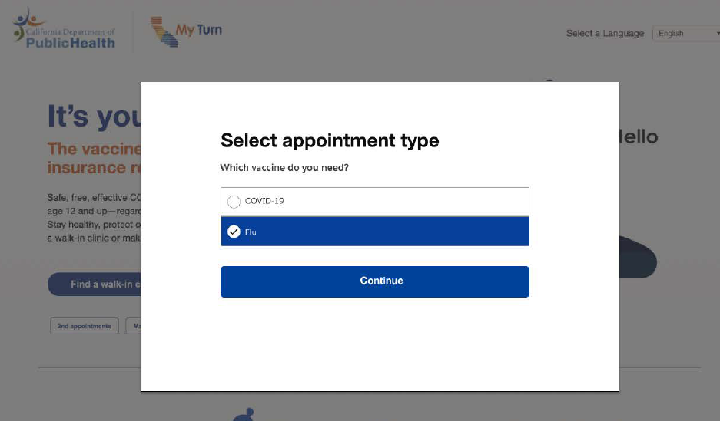
My Turn Flu Mockup
Starting late September, patients can schedule annual flu vaccination and / or the COVID-19 vaccination at MyTurn.ca.gov
My Turn flu Landing Page
My Turn Home Screen
Minor Consent
Note: This is not final and certain patient information fields and/or screening questions may be rearranged
    * Launch date subject to change

Slide 44

Upcoming myCAvax Live Trainings
With so many opportunities for new Providers to onboard onto myCAvax, we’re hosting additional live training sessions. Providers can bring questions and receive support!
Sessions will be interactive and include a high-level overview of the myCAvax enrollment process.
September 15 through October 27, 2021, weekly sessions will take place on Wednesdays (10:00-10:30AM)
Sep 22 – Register Here I Sep 29 – Register Here

Slide 45
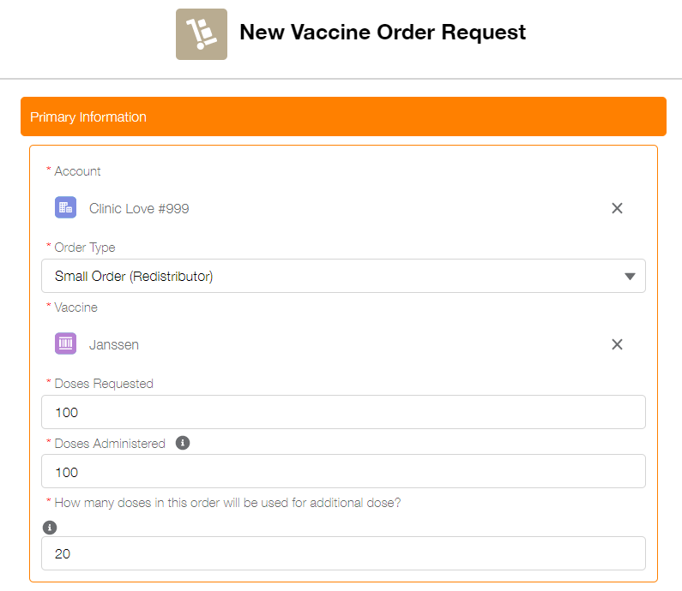

J&J Vaccine Available for Ordering
Ordering guidance and tips
Limited Janssen vaccine doses are now available for ordering through myCAvax
A 200-dose cap initially included has been removed
No expiration extension for this product
Many lots of this vaccine will be expiring soon (or by November)
Ordering Tips for Janssen:
Check on-hand inventory
Order / reorder what is needed

Slide 46
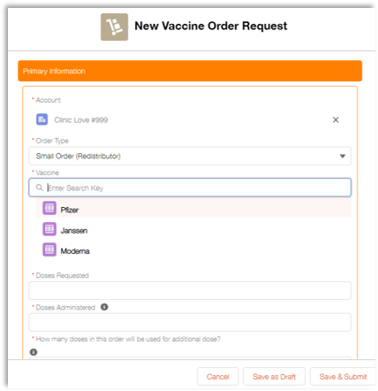
Ordering Reminders
Report doses administered and on-hand inventory
Determine vaccine need
  Based on inventory on hand
  Current vaccination efforts
  Forecasted vaccination efforts -near future/Ordering period
  Reminder: New field added for determining # of doses in order to be used for the additional dose
Order as needed, every week
Consider order review/approval/delivery timelines

Slide 47
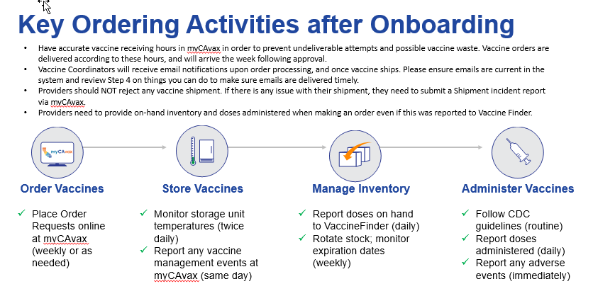

Slide 48
APPENDIX

Slide 49


myCAvax – Known Issues
Known Issues
Users Forced to Enter Fax Number
Some users are forced to enter a supply fax number during enrollment. The user may face issues when the fax number field is clicked. If so, it will require the user to enter a 10-digit fax number.
Workaround
Users may enter 5555555555 (without any special characters or spaces) to bypass the error message.
Estimated Fix 9/23
*As of 9/10

Slide 50

My Turn and myCAvax Feedback Form
The Governance and Continuous Improvement team is looking for feedback and suggestions from our LHDs and Providers.
Purpose
Direct line of communication for feedback and / or suggestions
Assist functional team in identifying and prioritizing enhancements
Help identify additional trainings and / or job aids needed
Please submit feedback here.

Slide 51
Wrap-Up & Resources
Leslie Amani, CDPH

Slide 52


Where can I go for additional help?
Type of Support
Description
Updated 9.1.21
The COVID-19 Call Center for Providers and Local Health Departments is dedicated to medical providers in California and their COVID-19 response, specifically addressing questions about State program requirements, enrollment, and vaccine distribution, including the Vaccine Marketplace.
  Email: covidcallcenter@cdph.ca.gov
  Phone: (833) 502-1245, Monday through Friday from 8AM–6PM
COVID-19 Provider
Call Center
Enrollment Support
For Provider enrollment support, please contact myCAvax Clinic Operations at
Email: myCAvaxinfo@cdph.ca.gov
Dedicated staff provide up-to-date information and technical support on the myCAvax system.
Email: myCAvax.HD@Accenture.com
Phone: (833)-502-1245, option 2, Monday through Friday 7AM–7PM, Saturday and Sunday 8AM-1PM
For training opportunities: https://eziz.org/covid/education/
myCAvax Help Desk
For onboarding support (those in the process of onboarding): myturnonboarding@cdph.ca.gov
For technical support: MyTurn.Clinic.HD@Accenture.com or (833) 502-1245, option 4: Monday through Friday 7AM–7PM, Saturday and Sunday 8AM–1PM.
For job aids and demo and training opportunities: https://eziz.org/covid/myturn/
My Turn Clinic Help Desk
CalVaxGrant Program Support
For questions and support around CalVaxGrant, contact the program's administrator, Physicians for a Healthy California.
Email: calvaxgrant@phcdocs.org
Phone: (916) 551-2565

Slide 53



Hear it? Clear It.
If you see or hear of any vaccine-related rumors within the communities you serve, share them with our Trust and Safety team via the CDPH Rumors Inbox.
Trust and Safety Team
Our shared mission is to reduce COVID-19 vaccine hesitancy and increase vaccination across the State of California.
How You Can Help
You are critical in our effort to provide Californians accurate and timely information around
COVID-19 vaccination.
Monitor What You See and Hear
Monitor online media and what you hear in your local communities for potential rumors and inaccurate information.
If found, report it to rumors@cdph.ca.gov
Contact
CTA

Slide 54
Provider Office Hours Q&A
Please use the Q&A panel to comment or ask a question:
Q&A Panel
Open the Q&A panel
Select Ask: All Panelists
Enter Text, Click Send
Notes:
Grace:
- Welcome all, the webinar
- Two ways to communicate (Cecilia's script)
- Introduce Kathleen

Slide 55

Thank you!
Monday:
My Turn & myCAvax Office Hours Link
Monday, September 20, at 12:00 PM
Audio Conference: 415-655-0001
Access Code: 145 995 8782
Session Number: 145 995 8782
Session Password: Immunize2020!
Next Friday:
Provider Office Hours Link
Friday, September 24, at 9:00 AM
Audio Conference: 415-655-0001
Access Code: 145 195 9307
Session Number: 145 195 9307
Session Password: Immunize2021!

